Slide 1
Building a 2 KW SSPA for 23cm
ON7UN Orebro May 25 2019

Slide 2
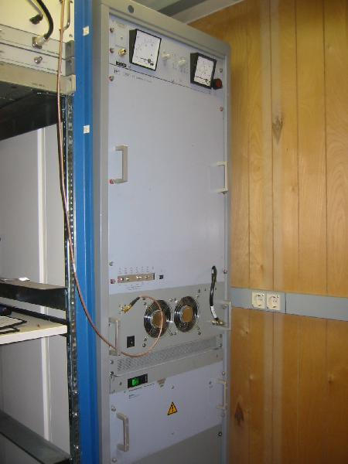
My th327 Tube amplifier
Heavy and noisy
A lot of heat to dissipate
But VERY reliable
2 KW output power
Wanted something new
Needed to fit behind the dish
Minimum Coax loss to the feed

Slide 3
Design Criteria
Same or more power than the tube amplifier
Remote controllable from shack
RF parts to be installed behind the dish to minimize losses
Protection against over current, over temperature, high VSWR, over input power
Modern touch screen display
Accessible over IP
Minimum of wire connections between the amplifier and the shack

Slide 4
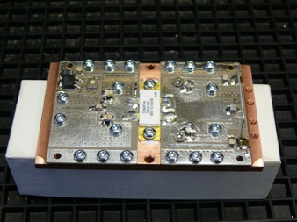
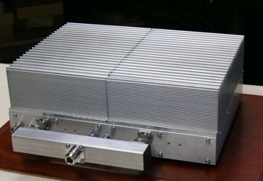
Labetech produced amplifier pallets
Lars SM4DHN produces pallets based on NXP BLF6G13l-250P devises
Each module produces 250 watt
Combinations of 2 or 4 pallets available
Solid and compact design
48V DC needed @ 10A needed per pallet of 250W
Total of 80 A PS needed @ 48 VDC

Slide 5
Inside the 1 KW amplifier

Slide 6
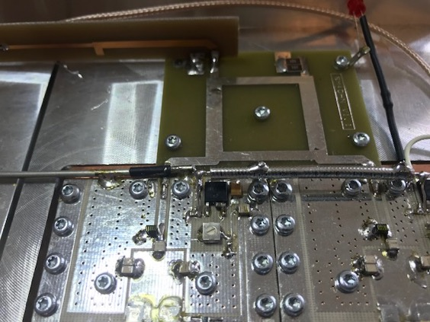
Modification of bias and adding NTC

Slide 7
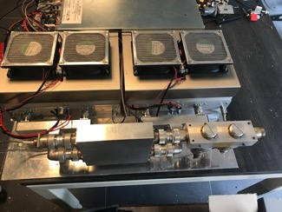
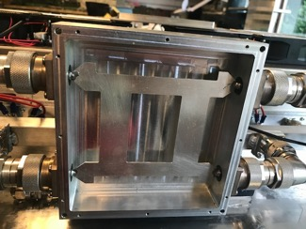
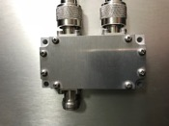
Combiner for two 1KW bricks
Used a DJ9BV style 90° hybrid coupler on output
Small PCB based 90° on input
500 W load on the dump port
Used 7/16 adaptors for minimal losses
Input combiner

Slide 8
Combiners and output coupler

Slide 9
The Out Door Unit ( ODU )
The ODU has the two amplifier modules of 1 kW installed
Input and output combiner for 60 watt input power and 2 KW output
Three phase power supply capable of 5 KW AC
Solid state DC switches for activating 48 VDC
Output coupler for measurement of Fwd and Ref power
0,5 mili ohms shunt for measurement of I Drain
Linear Detector AD8313 for power measurement

Slide 10
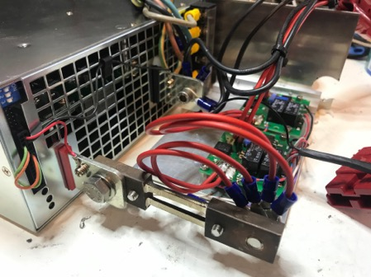
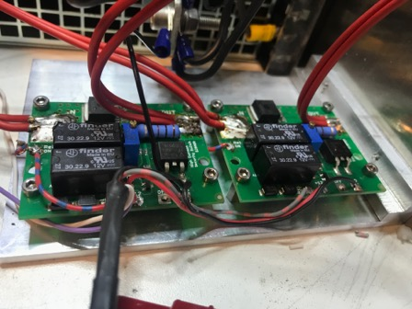
Power supply
Power supply is a mean well 3 phase 5000 watt DC
Two Solid state switches with high current shut off installed
Large 0,5 mOhm resistance for current sensing

Slide 11
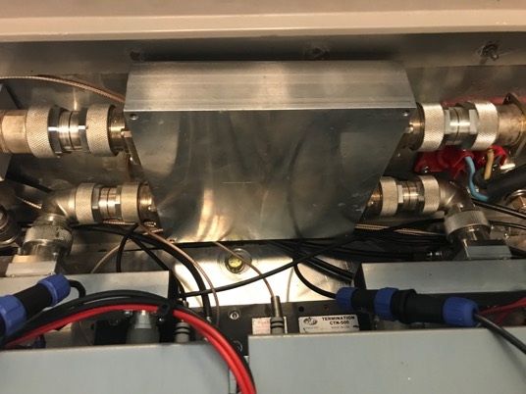
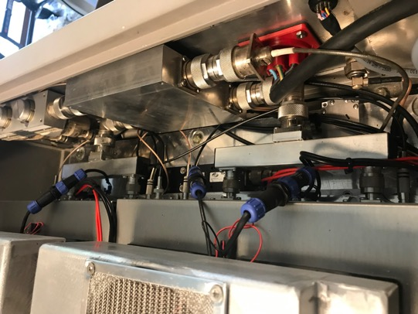
Output Combiner
Combining the two 1 kW amplifier blocks

Slide 12
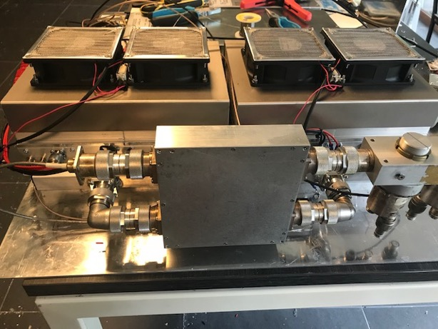
ODU
Power supply and two amplifiers
Output combiner , two brick amplifiers and output coupler

Slide 13
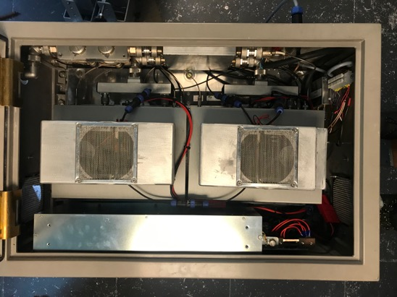
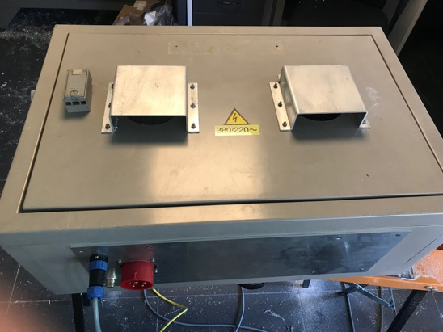
ODU
Completed ODU box

Slide 14
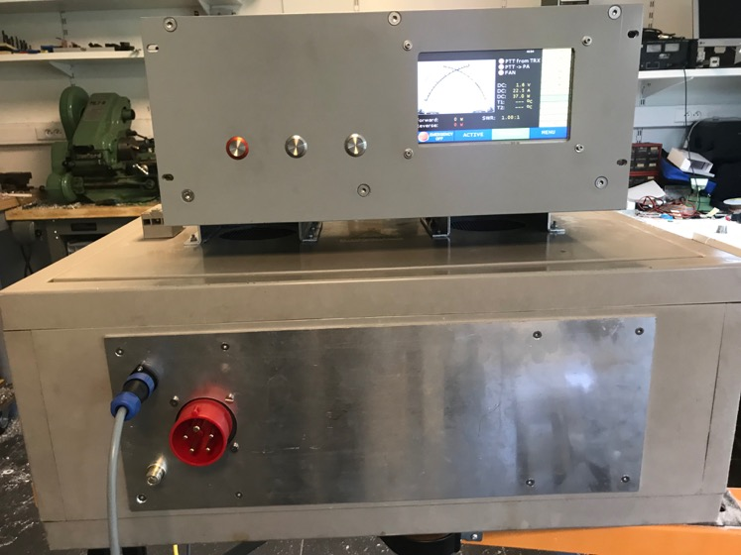
Indoor and outdoor units

Slide 15
The In Door Unit ( idu )
IDU to be installed in equipment shelter just below the antenna
A 12 wire cable connects the IDU to the ODU for measurement and control
An amplifier module capable around 100 watt based on 4 pcs Mitsubishi RA18H1213G
Power supply for the intermediate amplifier + separate PS for logic
A Helitron 7” amplifier control board for all the control and maintenance
Including a WIFI interface for remote controlling the amplifier
Solid housing in a milled 19” setup

Slide 16
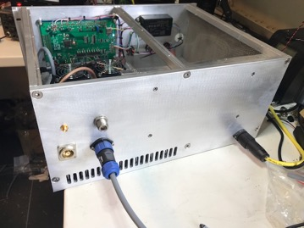
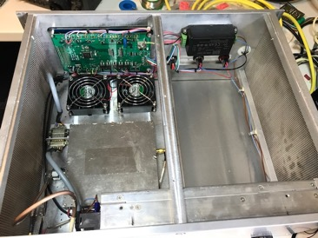
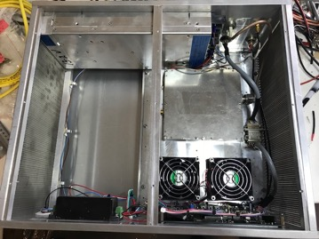
IDU

Slide 17
Helitron 7” amplifier controller
Kurt DJ0ABR designed a complete amplifier controller
Measurement inputs for voltage, current, power and temperature
Outputs for controlling FAN’s , Solid State switches, bias and antennas
Limits and alarms can be set in the software
Solid state DC switches are available with over current shut down
Large 7” touch LCD screen
Build in WIFI interface for remote control
More information : www.helitron.de

Slide 18
48VDC solid state Switch
Capable of switching 44 A at 48 V
Pré charging of the electrolitics in the PA a few tends of a sec
Very fast shut down in case of alarms
Over current protection adjustable between 20 and 40 A
Controlled by the amplifier controller

Slide 19
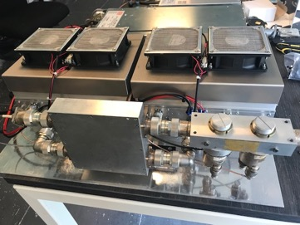
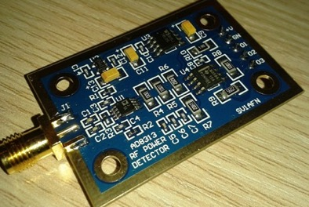
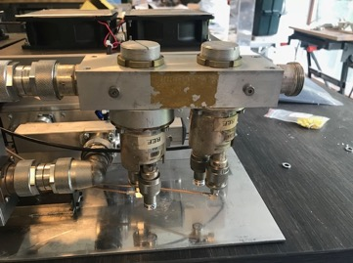
Power measurement
A surplus R&S coupler
For linear power detection the AD8313 is used
Boards by SV1AFN

Slide 20
The controller

Slide 21
The connections

Slide 22
7” Touch Screen Display Module

Slide 23
Different display setting

Slide 24
Overview display

Slide 25
Analog Digital values

Slide 26
Calibration of the power meter

Slide 27
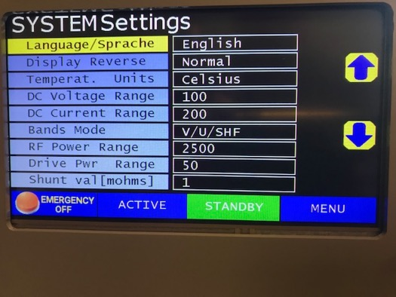

Slide 28
Integrated webserver
A Wifi interface build in
To control the amp over the network
Amplifier can be switched on/off and other parameters can be read.
Can connect to your WLAN or act as an Access point

Slide 29
Control screens

Slide 30
Still to do:
New firmware is available an I need to flash the new version
The new version has a mono band selection
Mounting the ODU behind the dish

Slide 31
Thanks for your attention

