Slide 1
Rebuilding the ON0EME power amplifier
ON7UN Orebro May 25 2019

Slide 2
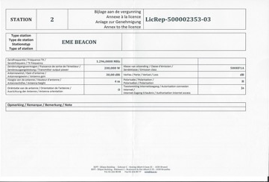
Some History
The Idea started at the Swedish EME conference in Orebro in April 2011
The ON0EME 1296 Moon beacon started transmission on March 31st 2012
After 3 days of operation the first PA failure was a fact
Every 3 to 6 months one of the two PA’s failed and needed repair, however not one FET got lost, only couplers burned out !
In 2015 heating/ventilation to the beacon box was added and this was a big improvement in the reliability.
In 2018 our local regulator wanted to bring down the power limit to 20 watt but after some consultations we got our original high power license back early this year. Apparently the military or civil L band radar did not have any interference from the moonbeacon

Slide 3
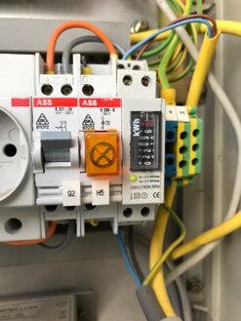
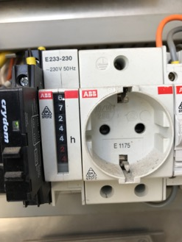
Some FActs
ON0EME made 2.600 moon passes so far transmitting high power signals to the moon
That is about 1,9 million sequenses _.. . _ _ _ _. _ _ _ _ _ . _ _ . ( DE ON0EME )
That is some 675.000 minutes of pure carrier or 11.250 hours or 470 days or 1,3 years
That is also 22.000 kWh of electrical power needed for the beacon

Slide 4
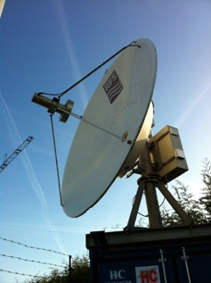
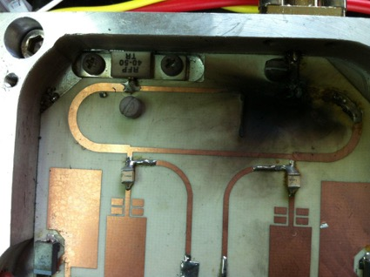
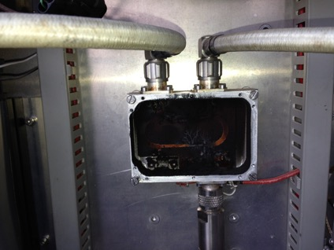
Problems encountered in 7 years of operation
After very high wind ( + 100 km/h ) the AZ pointing seems to be slightly off
Problems with the power amplifiers and couplers

Slide 5
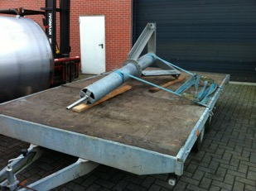
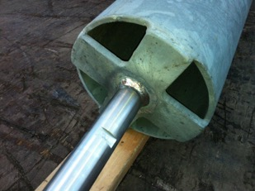
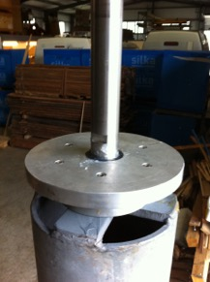
Problems with antenna pointing
Twice we found the antenna pointing off the moon after very high wind storms.
The only Root Cause we can think of is a broken weld on top of the mount

Slide 6
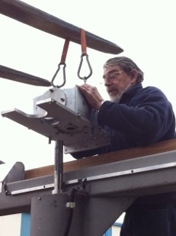
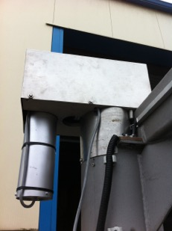
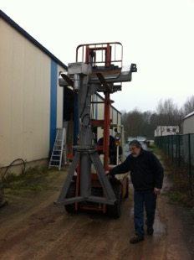
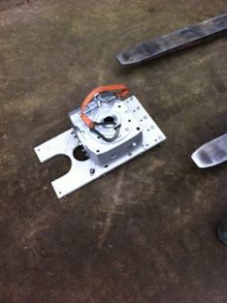
Problems with antenna pointing
Encoder shaft is directly connected to the fixed mount and the housing is taken by the gearbox
So only if the fixed part of the mounting would move, the encoder can be off
To check this, the complete antenna and mount needs to be dismantled

Slide 7
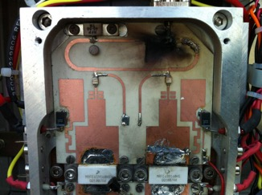
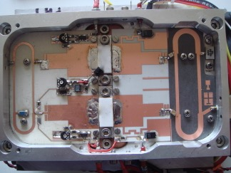
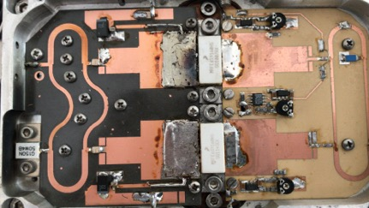
Problems with the Power amplifiers
First problem with the power amplifiers happened after a few days of operation
The output circuit was made on Ro4003 and it seemed it could not handle the power output
In a second version the output coupler got replaced by a Ro5890 PCB
In a third version the complete output board was replaced by a Ro5890 PCB

Slide 8
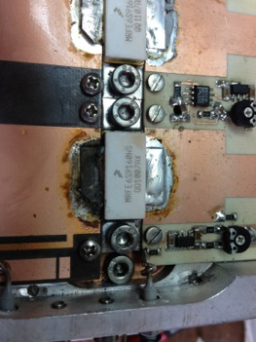
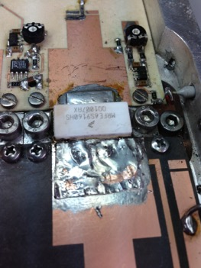
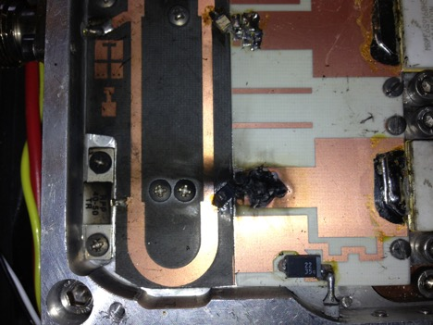
The FET’s peeled off the board
Also the FET’s “desoldered” themselves from the board material
ATC100B capacitors burned off the boards

Slide 9
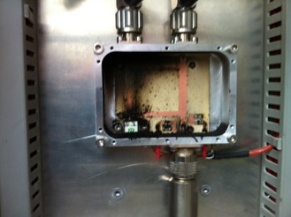
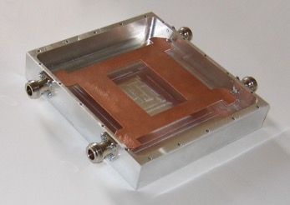
Final Output hybrid coupler failed
First model based on Ro4003 to combine two 250 watt modules
Second model made on Ro5890
Third model is a air coupler DJ9BV design

Slide 10
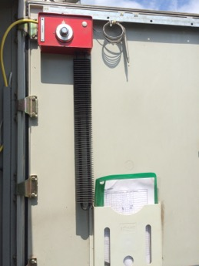
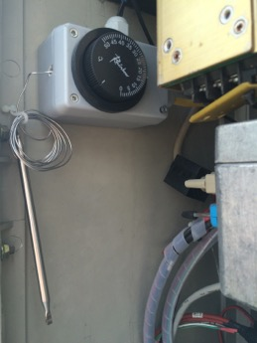
Looking for solutions
Found some humidity under the boards
Installed a heating and cooling Inside the beacon box
We keep the temperature above 15°C

Slide 11
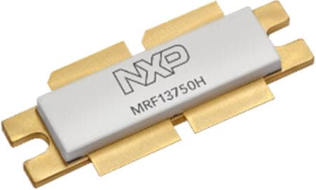
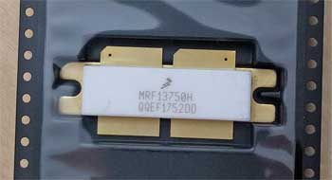
New devices arrived on the market
MRF13750H a 50V LDMOS device appeared on the market, a 700 to 1300 MHz capable of 750 watt CW power

Slide 12
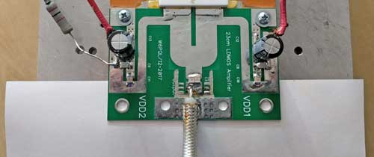
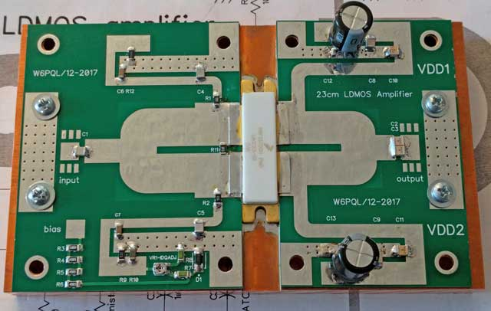
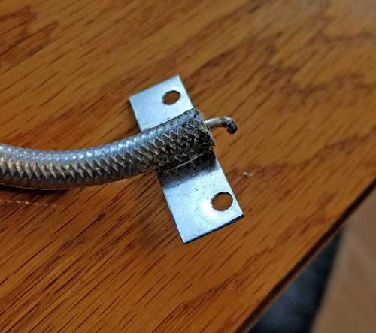
W6PQL developed a board
W6PQL sells a complete working pallet, and a kit
Device is available from W6PQL, Mouser, or from a Chinese seller on Ebay

Slide 13
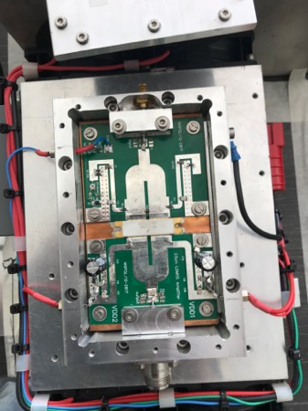
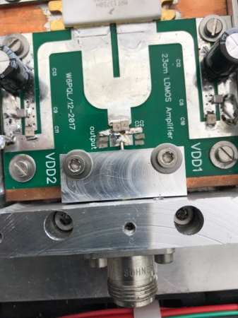
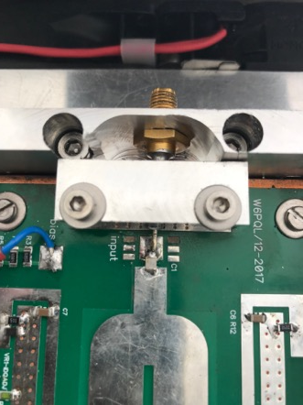
Trying to improve in and output connectors
Machined a new housing + clamps
A good N connector to coax adaptor from Suhner

Slide 14
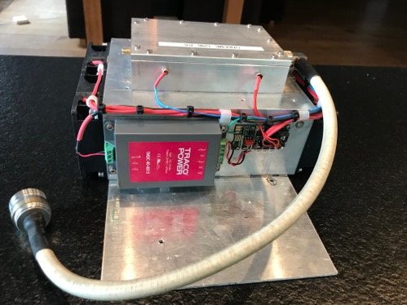
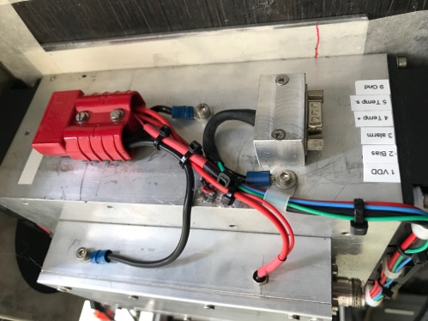
Machining a new housing
DC/DC converter to convert 48VDC to 24VDC for the Fan’s
Kuhne PWM circuit to control the fans

Slide 15
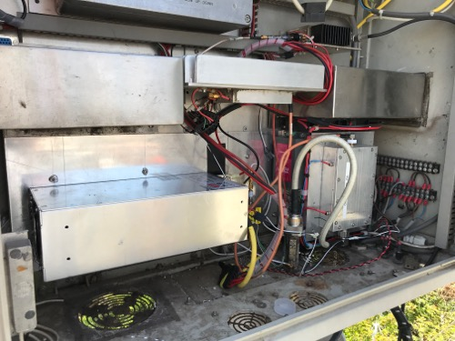
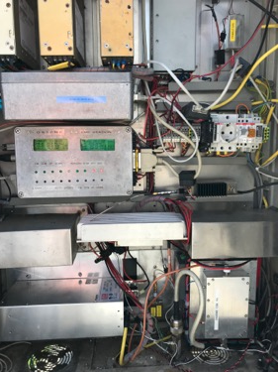
New Mean Well 1500 watt power supply
A new 48 VDC power supply was needed

Slide 16
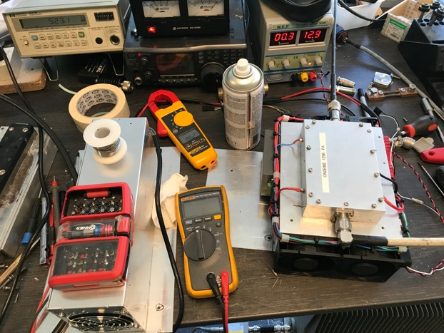
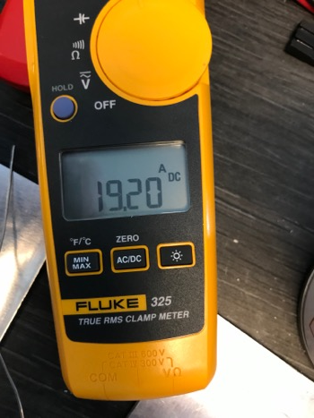
New PA installed
On April 26th the new PA and power supply got installed 48 VDC 19,2 A ID

Slide 17
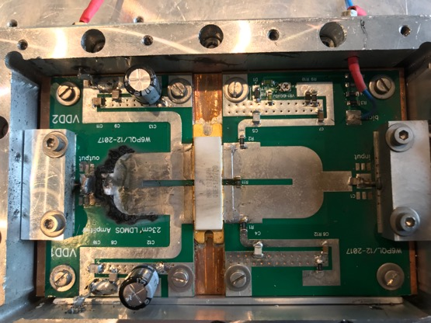
3 days later the new PA failed !
On April 30 I noticed NO OUTPUT in the monitoring and a higher heatsink temperature
It looked like the device was still OK.
The device has survived one moon pass with no output capacitors connected !

Slide 18
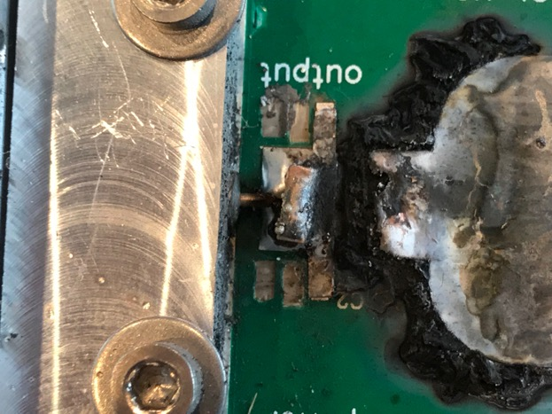
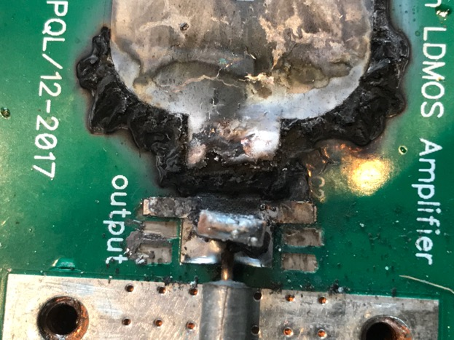
More damage pictures

Slide 19
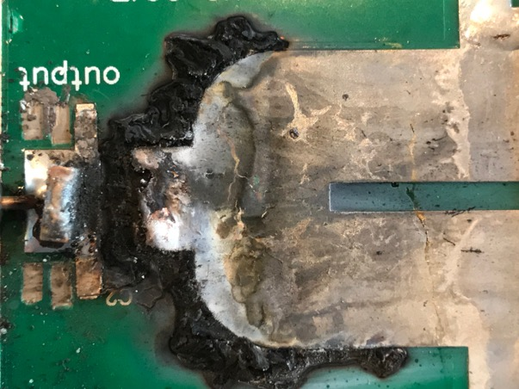
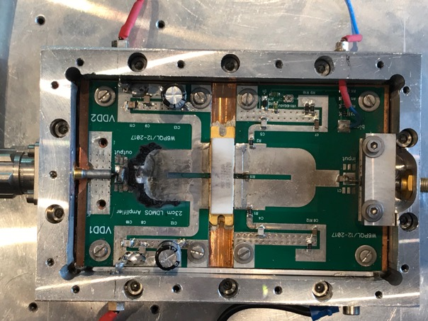
And more ….

Slide 20
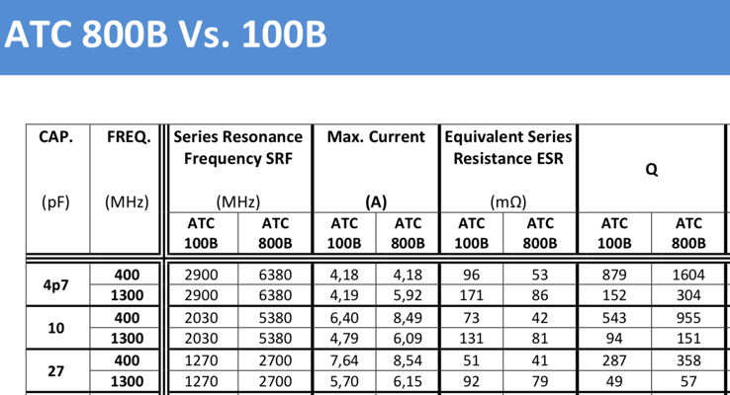
Repair of the new PA
I had a spare KIT so had a new output board
Checked the specs of the ATC100B capacitors, datasheet says max 5,7 A at 1300 MHz
ATC800B is slightly better
500 Watt in 50 Ohm is 10 A so at the limit for two 18 pf output capacitors in parallel

Slide 21
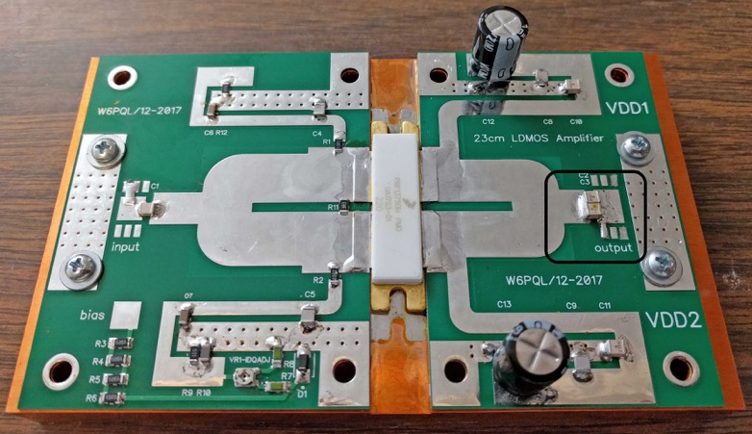
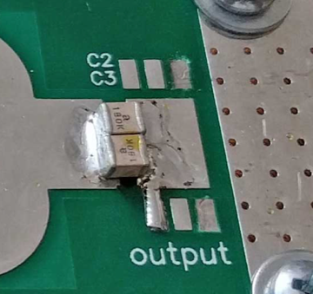
Original output capacitors ATC100B

Slide 22
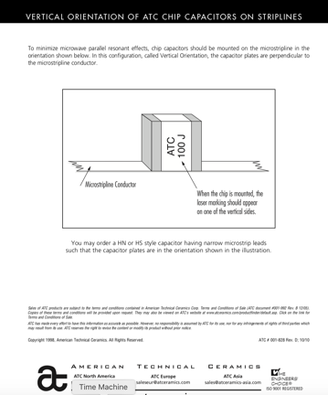
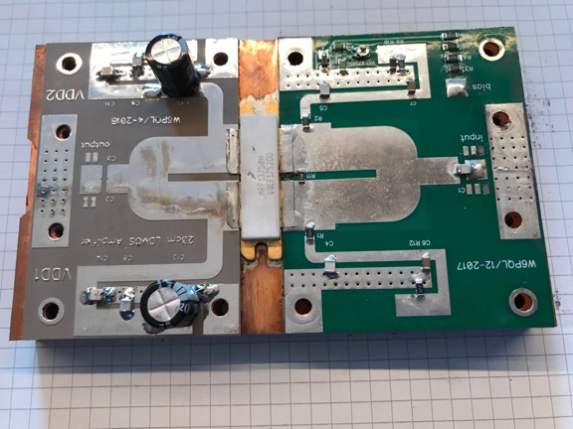
Vertical mounting of the ATC’s
Found a paper from ATC where vertical mounting of the capacitors is recommended.
Prepared a new output board

Slide 23
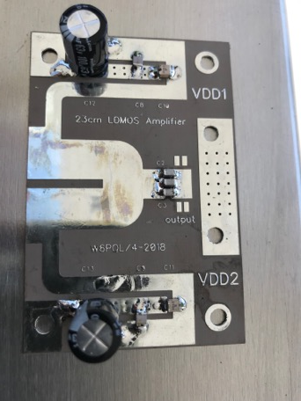
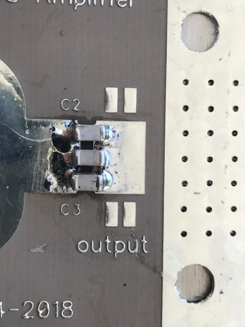
New output board preparation
Changed 2 pse 18 pf ATC100B to 3 pse 12 pf ATC800B, Vertical mounted

Slide 24
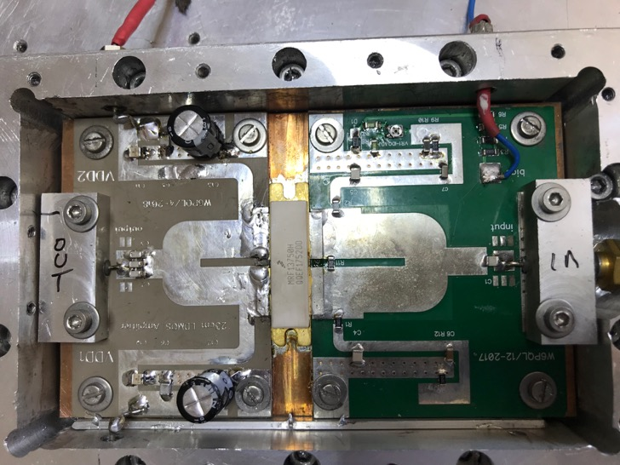
New output board installed

Slide 25
New test
Reduced VDD to 42 VDC
Efficientcy got better
PAE = (517 – 7) / (42,0V * 19,2A) * 100 = 63%

Slide 26
Repaired PA installed in the beacon

Slide 27
Spare boards
Spare boards got ordered
Convinced W6PQL to offer bare boards without components
Hopefully we do not need any

Slide 28
Future improvements ?
Andreas DJ3JJ suggested to install ATC QBRIDGE in between the caps
Found no heating of the caps , tested 15 min key down full power
Device temperature was under 45° after 15 min key down

Slide 29
Results so far ?
Beacon with the repaired PA is operational since May 14th 2019 so 10 days now.
All parameters seem OK temperature of the heatsink between no power and opeartional is around 25 °C
Temperature of the capacitors seems to be under control
No more couplers in the beacon gives me confidence the MTBF or reability improved

Slide 30
Thanks for your attention !

